Slide 1
Employee Data Analysis using Excel
STUDENT NAME: HARISH D
REGISTER NO: 312218460
DEPARTMENT: B.COM (G)
COLLEGE : GOVT ARTS AND SCIENCE COLLEGE PERUMBAKKAM.
NM ID : #B754540F42AF3F49AC54918FC7354F74

Slide 2
PROJECT TITLE
Employee Performance Analysis using Excel

Slide 3


AGENDA
Problem Statement
Project Overview
End Users
Our Solution and Proposition
Dataset Description
Modelling Approach
Results and Discussion
Conclusion
3/21/2024 Annual Review

Slide 4

PROBLEMSTATEMENT
The organization is facing challenges in accurately evaluating and improving employee performance due to a lack of structured data analysis methods. Current evaluation processes are largely manual, leading to inconsistencies, delays, and potential biases in performance assessments. Additionally, the company lacks a comprehensive view of employee performance trends over time, which hinders informed decision-making for promotions, training, and other HR interventions.
To address these issues, the project aims to develop an Excel-based solution that will systematically analyze employee performance data. This solution will include data aggregation, statistical analysis, and visualization tools to identify key performance indicators (KPIs), trends, and outliers. The goal is to provide the HR department with actionable insights that are data-driven, consistent, and easily interpretable.
By the end of the project, the organization should have a robust Excel model that enables accurate, timely, and unbiased employee performance evaluations, contributing to better workforce management and overall organizational productivity.

Slide 5

PROJECTOVERVIEW
The primary objective of this project is to develop an Excel-based tool that can effectively analyze and evaluate employee performance data. This tool will enable HR managers and team leaders to gain actionable insights into employee performance, identify trends, and make informed decisions regarding promotions, training, and resource allocation.Scope:
This project involves collecting, organizing, and analyzing employee performance data, including metrics such as productivity, quality of work, attendance, and peer/managerial reviews. The analysis will be conducted using Excel's advanced functionalities, such as pivot tables, statistical functions, and data visualization tools. The project will also involve creating dashboards and reports that summarize key performance indicators (KPIs) and provide a clear picture of individual and team performance over time.
.
Key Features:
Data Collection and Organization:Compile and clean existing performance data from various sources (e.g., HR systems, employee reviews, productivity reports).Structure the data in Excel for easy analysis, ensuring consistency and accuracy.
Performance Metrics Analysis:Calculate key performance indicators (KPIs) such as productivity rates, quality scores, and attendance records.Use pivot tables and charts to segment data by department, role, or individual employee.
Trend Analysis:Identify performance trends over specific periods (monthly, quarterly, yearly).Highlight top performers and those needing improvement.

Slide 6

WHO ARE THE END USERS?
Managers: Assess and track employee and team performance for decision-making on promotions and development.HR Professionals: Use data for performance reviews, training needs, and strategic planning.Team Leaders: Monitor team performance, provide feedback, and identify areas for improvement.Executives: Review aggregated data for organizational insights and strategic decisions.

Slide 7

OUR SOLUTION AND ITS VALUE PROPOSITION
Training and Development: Create targeted training programs to address skill gaps.Incentives: Design performance-based incentives to motivate employees.Process Improvement: Optimize workflows and improve communication to enhance productivity.Feedback and Coaching: Implement regular feedback and coaching sessions.

Slide 8
Dataset Description
Employee ID: Unique identifier for each employee.Name: Employee's full name (often anonymized in datasets).Department: The department or team the employee belongs to.Job Title: The role or position held by the employee.Date of Hire: The date the employee started working with the organization.Years of Experience: Total years of experience the employee has, both within and outside the organization.

Slide 9

THE "WOW" IN OUR SOLUTION
Real-Time Performance Tracking:Enables immediate monitoring and adjustments to employee performance, promoting agility and continuous improvement.Advanced Analytics and AI:Uses data analytics and AI to identify trends, predict outcomes, and recommend personalized actions, aiding in data-driven decision-making.

Slide 10
MODELING APPROACH
Employee data-Kaggle
‣ I take this data in the Naan Mudhalvan website and click the edunet dashbord . There we should update our Profile. Then click on the employee data set( Kaggle). It downloads in the PC.
Sort the Data:
Open the data through Excel, then select all the data in the sheet, then click the 'row and column' in the ribbon tab and choose the autofit row and column width option. Using the conditional format we fill the blank column by different colours. Select any features and highlight in our favorite colour.
Employee data-Kaggle
‣ I take this data in the Naan Mudhalvan website and click the edunet dashbord . There we should update our Profile. Then click on the employee data set( Kaggle). It downloads in the PC.
Sort the Data:
Open the data through Excel, then select all the data in the sheet, then click the 'row and column' in the ribbon tab and choose the autofit row and column width option. Using the conditional format we fill the blank column by different colours. Select any features and highlight in our favorite colour.

Slide 11
MODELLING
Pivot table:
Copy the selected features and paste it in new sheet. Select the all features and create the Pivot table. Order the features in this following as ROW: Employee status, Playzone COLOUMN: Employee type VALUES: Current employee rating FILTER: Gender Then the table will be created
PIVOT CHART:
Select the table and click the Pivot Chart option and choose our favorite chart example: Bar chart, Pie chart etc... Then we finish the chart

Slide 12
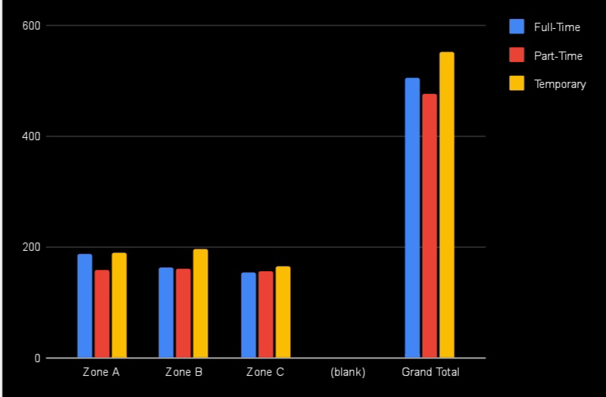
RESULTS

Slide 13
conclusion :
Performance Drivers:
Training, experience, and feedback are crucial for high performance.Employee Segmentation: Identifies performance clusters, guiding targeted interventions and recognition.Predictive Insights: Helps anticipate and address potential performance issues proactively.Recommendations: Focus on targeted training, recognition programs, and effective resource allocation.Bias and Fairness: Ensure evaluations are unbiased and equitable.

